Slide 1
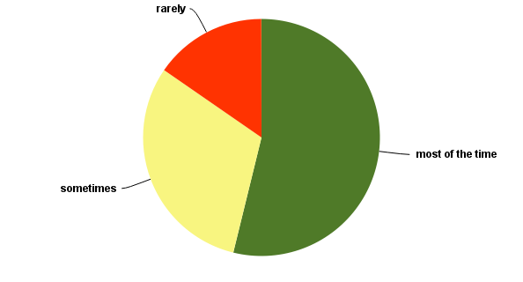
Q4: I can balance individual and institutional priorities.
Answered: 13 Skipped: 1

